Slide 1

CEMASTEA e-Learning Portal Laptop/Desktop User Guide
2025

Slide 2
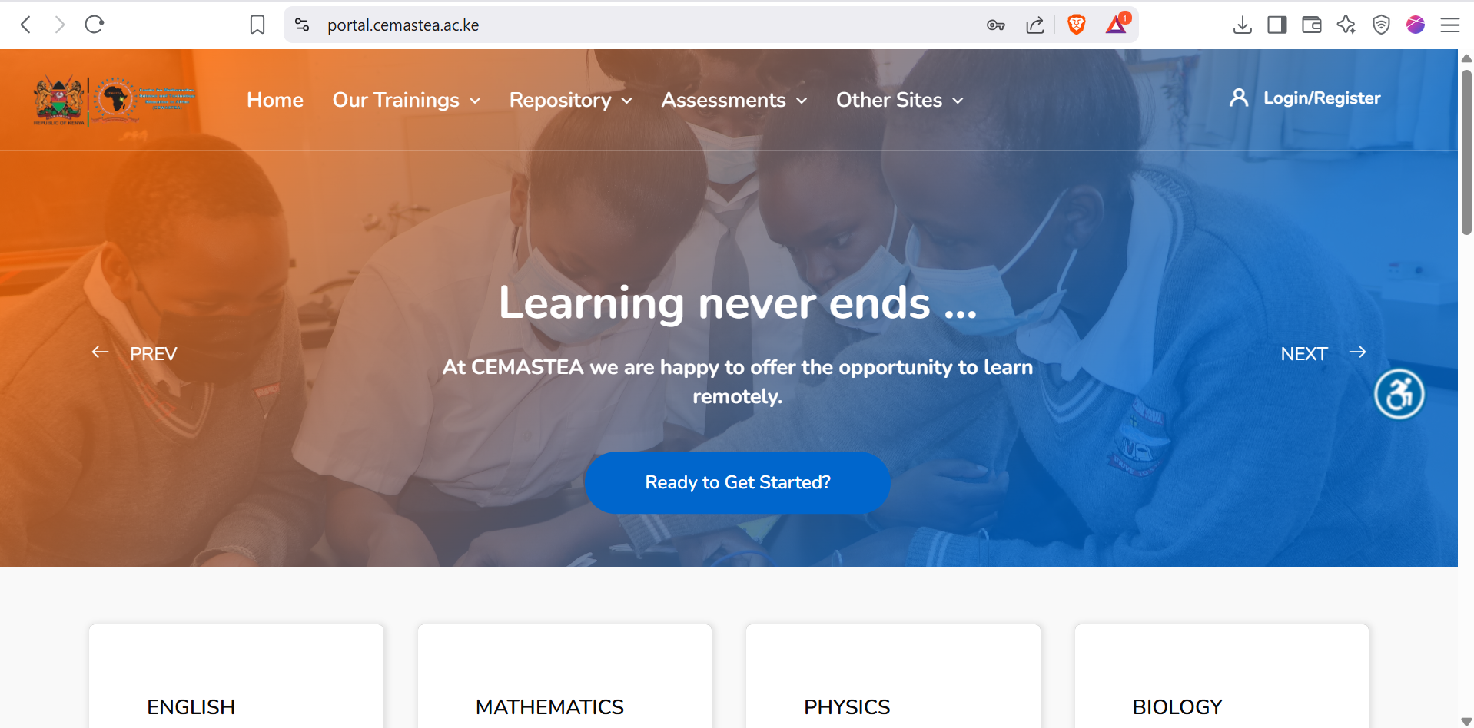
Login-In
Tap here to access menu bar

Slide 3
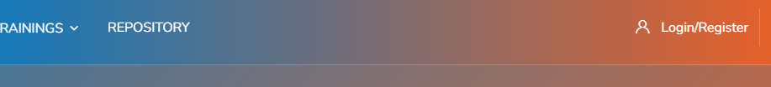
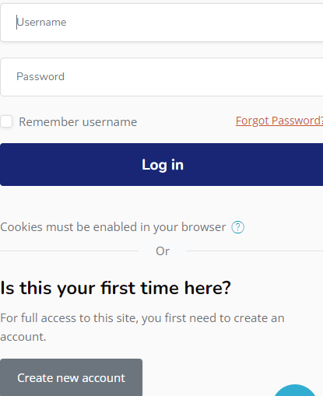
Computer version Log-in Cont..
Input your Username and password here
Tap here to Login or Register
Tap here to create a new account

Slide 4
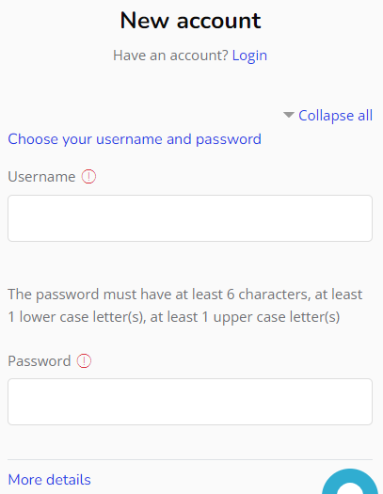
Filling details for a new account
NB: Ensure your password is strong mixed with Small letters , Uppercase Letters Characters and numbers. E.g. if you have a password like mary20,you can input M@ry20 as your password.
Once all required fields in the form are filled, click on Submit button.
NB: check Inbox/Spam folder of email used in registration for confirmation link

Slide 5
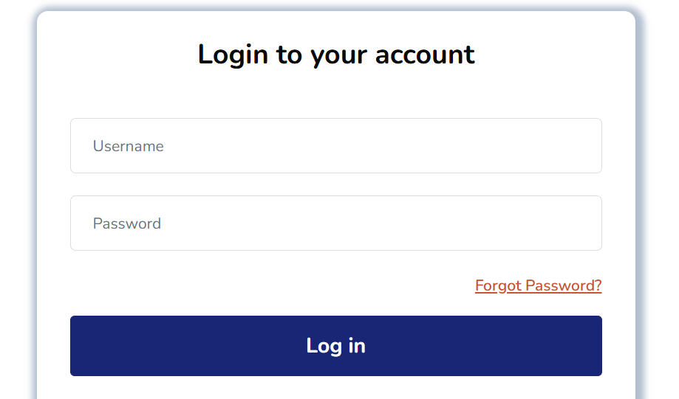
Accessing Courses

Slide 6
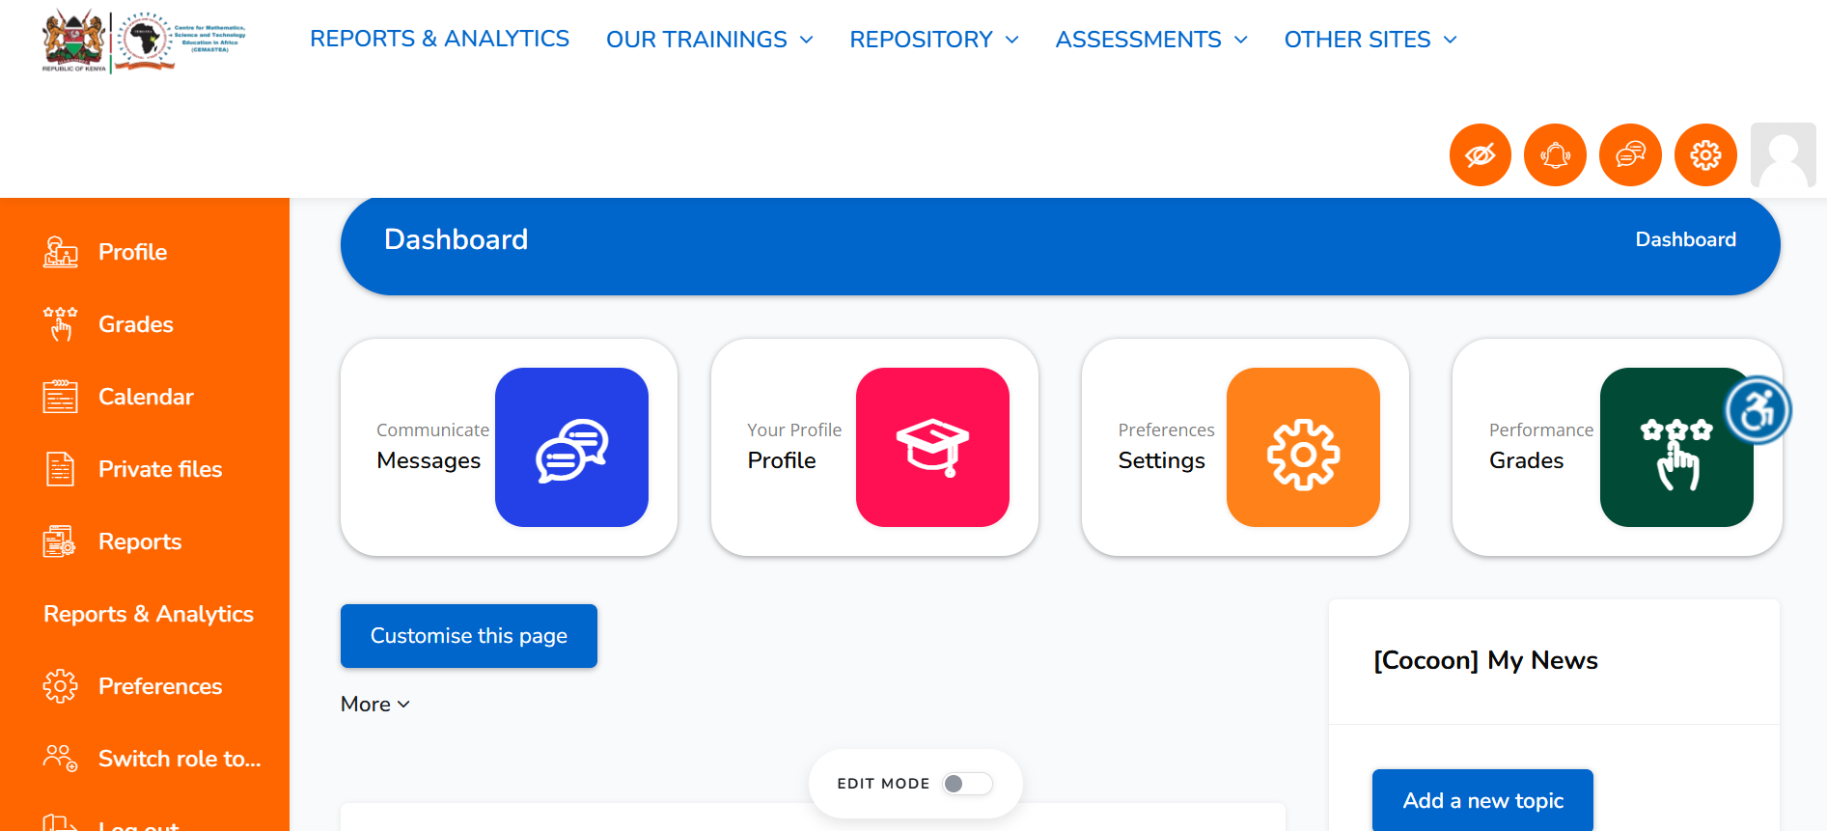
Accessing Courses
Tap on Our Trainings

Slide 7
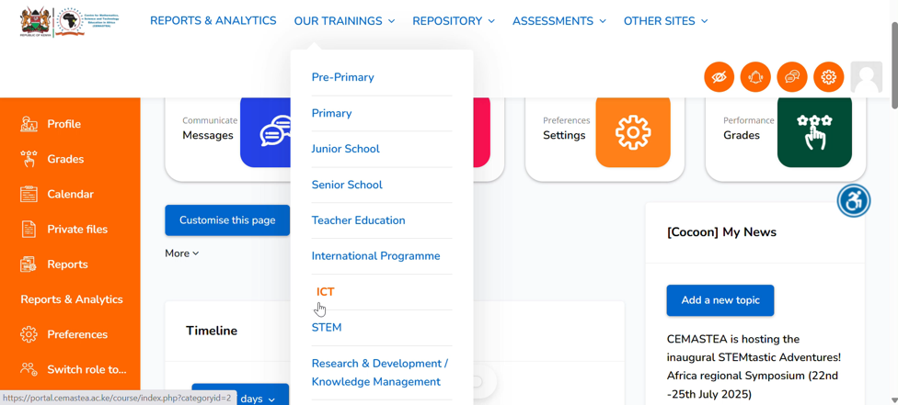
Accessing Courses cont..
Tap here to access training courses
Tap here to access ICT training courses

Slide 8
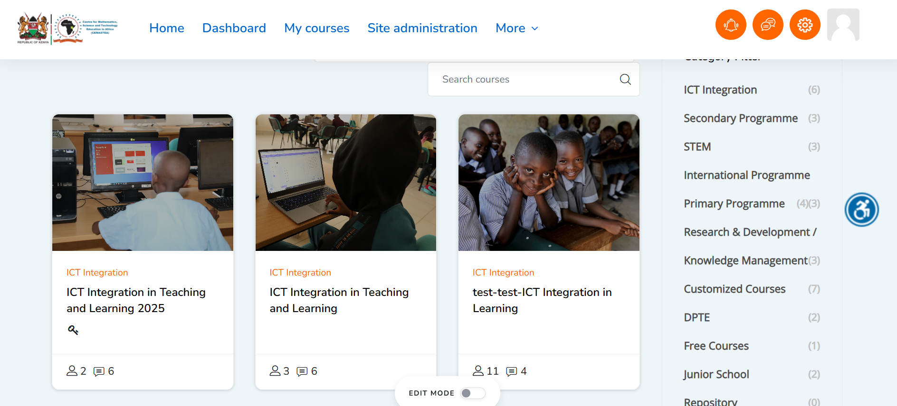
Accessing Courses cont..
Tap on ICT Integration in Teaching and Learning 2025

Slide 9
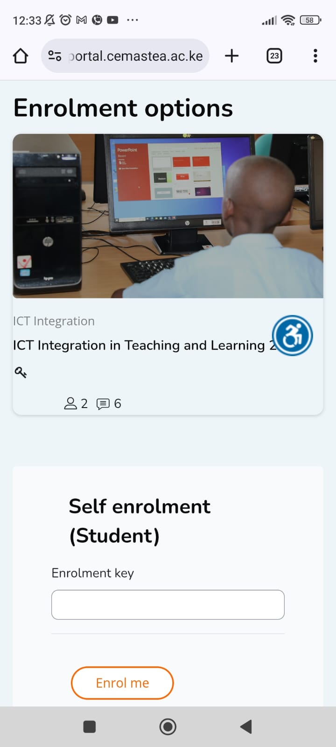
Enrollment
Key in the Enrollment Key provided by the facilitator to enroll yourself in the course.
Insert Enrollment Key here

Slide 10
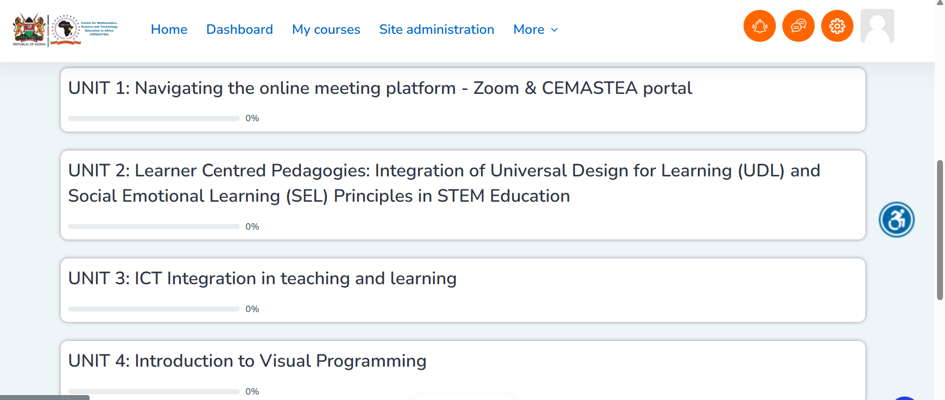
Course Content
Tap on the Units to access the content

Slide 11
THANK YOU

